Slide 1
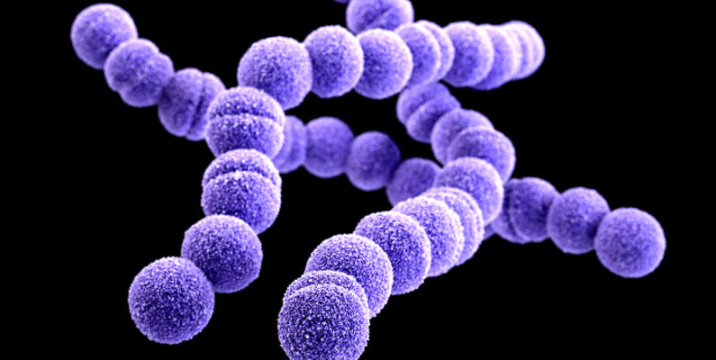
676 cases of Pharyngitis in children
JiaTong Lyu
Meher Satya Swaroop Malina​

Slide 2
Agenda
1
2
3
4
5
Goal
Dataset
Preprocessing
Best model
Summary

Slide 3

Goal
Children with Pharyngitis
Signs
Symptoms
RADT for Group A streptococcus (GAS)
Help the physicians decide whether they can rely on signs and symptoms to select pediatric patients with pharyngitis who should undergo rapid antigen detection testing (RADT) for GAS.

Slide 4
Dataset
676 cases of children with pharyngitis.
20 attributes
Target variable : radt
There are 4 numeric and 16 categorical attributes

Slide 5
Dataset
age_y | radt | pain | swollenadp | tender | tonsillarswelling | exudate | temperature | sudden | cough
7 | 0 | 1 | 1 | 0 | 0 | 0 | 37 | 1 | 1
11.7 | 1 | 1 | 1 | 0 | 0 | 0 | 38 | 1 | 0
5.6 | 1 | 1 | 2 | 1 | 1 | 0 | 37 | 1 | 0
6 | 1 | 1 | 2 | 1 | 1 | 0 | 40.8 | 1 | 0
5.2 | 0 | 1 | 2 | 0 | 1 | 0 | 40 | 1 | 0
4 | 0 | 0 | 2 | 0 | 0 | 0 | 38 | 1 | 0
8.2 | 1 | 1 | 1 | 1 | 0 | 0 | 38 | 0 | 1

Slide 6

Data Preprocessing

Slide 7
EDA
371 cases - negative RADT result 305 cases - positive RADT result
164 rows with missing data

Slide 8
Handling Missing Data​
​k-NN imputation (k=1)
​A new sample is imputed by finding the sample in the training set “closest” to it and averages these nearby points to fill in the value.
A threshold of 0.5 is used to round the imputed value to 0 or 1.
k-NN imputation (k=5)
​A new sample is imputed by finding the 5 samples in the training set “closest” to it and averages these nearby points to fill in the value.
A threshold of 0.5 is used to round the imputed value to 0 or 1.
Logistic regression imputation
A logistic regression model with the missing value column as the target column was trained on the remaining samples and used to impute missing values.
A threshold of 0.5 is used to round the imputed value to 0 or 1.

Slide 9
Attribute selection
Chi-Square Test
Mutual info
ANOVA test
Recursive feature elimination
Feature selection with random forests
Note: Eliminated number attribute as it is just an id. Also, the attributes whose variance is less than 0.09 were eliminated before the attribute selection.

Slide 10
Attribute | Chi-square | Mutual info | ANOVA test | Recursive elimination | Random forests
age_y | Y |  | Y | Y | Y
radt | Target | Target | Target | Target | Target
pain |  | Y | Y | Y
swollenadp | Y |  | Y | Y | Y
tender | Y | Y | Y
tonsillarswelling |  | Y
exudate | Y |  | Y
temperature | Y | Y | Y | Y | Y
sudden |  | Y
cough | Y |  | Y | Y
rhinorrhea | Y | Y | Y
conjunctivitis | Eliminated due to low variance | Eliminated due to low variance | Eliminated due to low variance | Eliminated due to low variance | Eliminated due to low variance
headache |  | Y |  | Y
erythema | Y |  | Y
petechiae | Y | Y | Y | Y | Y
abdopain |  | Y
diarrhea | Eliminated due to low variance | Eliminated due to low variance | Eliminated due to low variance | Eliminated due to low variance | Eliminated due to low variance
nauseavomit | Y | Y
scarlet | Y | Y | Y | Y | Y

Slide 11

Model Building

Slide 12
Classification algorithms
Random forest
Adaboost with random forest
Adaboost with J48
KNN (k Nearest Neighbors)
Logistic regression
J48 Decision tree
Naïve Bayes
Support Vector Machines

Slide 13
Hyperparameter tuning
Hyperparameters such as
k in k-NN
random seed for Xval/%split in WEKA
No of iterations
Batch size

Slide 14
Evaluation metrics
Recall (class = 1)
F-measure
ROC
Accuracy
Note: Along with the important evaluation metrics like F-measure, ROC, and accuracy, this project requires a model to have high recall (class = 1) because a physician can’t afford to not recommend a RADT in a case that would actually be positive in RADT for GAS.

Slide 15
Best Model
Considering all the evaluation metrics, the best model is KNN (k=13) when trained with ANOVA f-test features selected dataset on a 66% - 33% train-test split, with an accuracy of 76.52%.
Also, it makes sense that KNN is the best model as most of the data is binary and the dataset is small. Getting an appropriate prediction depends on the k closest neighbors, and the binary data of the correlated attributes gives the best output in KNN as there’s a either 0% or 100% chance of getting it right.

Slide 16
Best Model
Considering all the evaluation metrics, the best model is KNN (k=13) when trained with ANOVA f-test features selected dataset on a 66% - 33% train-test split, with an accuracy of 76.52%.
Also, it makes sense that KNN is the best model as most of the data is binary and the dataset is small. Getting an appropriate prediction depends on the k closest neighbors, and the binary data of the correlated attributes gives the best output in KNN as there’s a either 0% or 100% chance of getting it right.

Slide 17
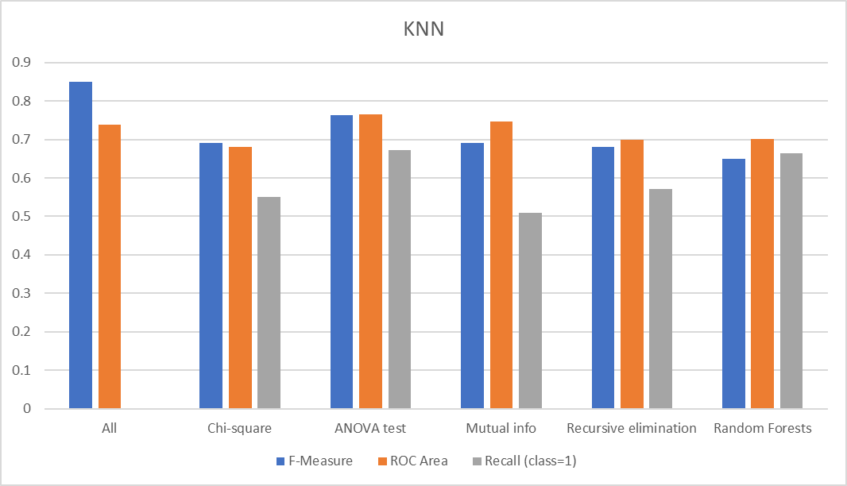
Analysis

Slide 18
Metrics
Model | Recall | F-Measure | ROC Area | Accuracy
KNN (ANOVA test) | 0.673 | 0.763 | 0.766 | 76.521
KNN base model | 0 | 0.849 | 0.739 | 89.645
Logistic regression (Chi-square test) | 0.622 | 0.715 | 0.774 | 71.739
Logistic regression (ANOVA test) | 0.612 | 0.715 | 0.766 | 71.739

Slide 19
Metrics

Slide 20
Observations
A model with a high accuracy does not mean it is a good model, as it could be learning only one class, and test set could have a high distribution of that class. Cross validation creates class imbalance in a few cases. One must perform stratified cross validation when dealing with small amount of data though the initial dataset is not highly imbalanced.
Decision trees are susceptible to overfitting.
Independent features have a huge impact on processing and as well the prediction when it comes to modeling with small amounts of data. Feature selection is important.
Accuracies vary a lot even for a single misclassification when the dataset is small.
For this dataset, good models have accuracies below 80% as the dataset is small and these models have a huge role to play in medicine for this problem given there’s more data.
There is no best feature selection method. Just like there is no best set of input variables or best machine learning algorithm.

Slide 21
Tools used
WEKA
Python
Pandas
NumPy
Sklearn
Matplotlib
Seaborn

Slide 22

Summary
In conclusion, after a series of experiments conducted using various data imputation methods, scaling methods, attribute selection methods, 10-fold cross validation and 66-34 percentage train-test split, 8 different algorithms, and evaluation metrics on the 676 cases of pharyngitis in children dataset, we found out that physicians can rely on a KNN(k=13) model trained with features selected from ANOVA f-test to help them decide if to recommend a child with pharyngitis to rapid antigen detection test for Group A streptococcus (GAS) given that there’s a 76.52% chance they would get the result of the test right.

Slide 23

Thank you
Jiatong Lyu
Meher Satya Swaroop Malina

